Slide 1

Histotoxic clostridia
Histotoxic clostridia are common pathogens of humans & domestic animals. A limited groups causes most of the infections.
Cl. perfringens
Cl. septicum
Cl. chauvoei
Cl. Novyi
The halmark is toxinogenesis. The acquisition of infecting organism from the soil or an endogenus source (intestinal tract), entry to tissue following trauma, local multiplication and toxin production resulting in extensive local & systemic damage & rapid death of the host. In animals control by vaccination has decreased the incidence.

Slide 2
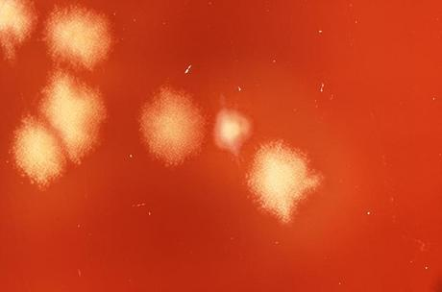
Cl. septicum
Cl.Septicum is commonly found in soil, & has been isolated from the faeces of domestic animals & humans. The organism has been isolated from snails that play a role in the life cycle of liver flucks as well as from the flucks recovered from sheep experimentally infected with the parasite.
The organism cause malignant edema in human with infection often associated with traumatic wounds, bowel carcinoma, DM, liver cirrhosis & vascular disease.
In addition to its role in myonecrosis, Cl. Septicum may also cause enteric infection. In lambs or older sheep the organism penetrate the abomasal lining & produces a disease known as Braxy, which is characterized by hemorrhagic, necrotic abomasitis & fatal bacteremia.
Cl. Septicum infection can manifest as gangrenous dermatitis in chicken.
Malignant edema in domestic animals usually follow direct contamination of a traumatic wound.

Slide 3
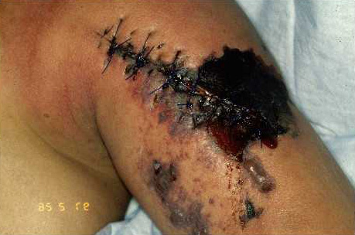
Pathogenesis
The pathogenic mechanism by which Cl. Septicum invade the abomasal lining is not known, but ingestion of cold or frozen feed is frequently an associated factor in both sheep & dairy calves. Impaired mucosal function may allow entry of the organism, followed by focal multiplication & dissemination throughout the body, producing local lesions & toxemia.
Toxic or potentially toxic products of Cl. Septicum include α- toxin (oxygen stable hemolysin), β-toxin (Dnase, leukocidin), γ-toxin (hyaluronidase), δ-toxin (oxygen labile hemolysin), neuraminidase, Chitinae, & sialidase. The α- toxin has a role in the pathogenesis of malignant edema & related conditions.

Slide 4
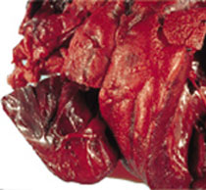
Cl.novyi
Cl.Novyi type C is nontoxogenic (avirulent), but type A & B as well as D cause disease in humans an domestic animals.
Strains of type A cause gas gangrene in humans & wound infection in animals. The hallmark lesion is edema & bighead of young rams. The rapidly spreading edema of the head, neck, and cranial thorax follows bacterial invasion of subcutaneous tissue damaged by fighting.
Cl.Novyi type A has been recognized as a cause of septicemia in drug addicts(IMDUs).
Infectious necrotic hepatitis (Black disease) of sheep & cattle result from C.novyi type B infection. Dormant spores germinate in liver tissues, often damaged by fluke migration & systemic effects with acute or peracute death follow dissemination of α- toxin . The name black disease derived from the characteristic darkening of the underside of the skin as a result of venous congestion.

Slide 5
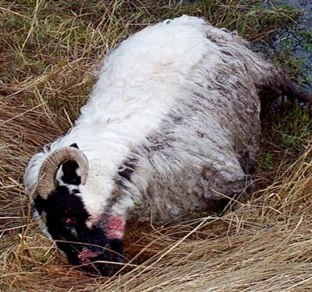
Cl.novyi
Cl.Novyi type D (Cl.hemolyticum) causes bacillary hemoglobinuria of cattle & other ruminants. Stain of type D resemble hose of type B, except that type D strains produce no α- toxin and much more β-toxin . Bacillary hemoglobinuria is most common in well-nourished animals more than 1 year of age.
β-toxin causes hepatic necrosis & dissemination through the bloodstream leads to intravascular hemolysis & hemorrhage. Fever, pale mucous membranes, anorexia, abdominal pain & hemoglobinuria (from which common name red water is derived).
Typical clinical signs when hemoglobinuria appears 40-50% of red cells have been lysed, & finally death occur.
The pathogenesis of bacillary hemoglobinuria is similar to that of black disease of sheep, except that the primary toxin is β-toxin rather than α- toxin . A typical case fatality rate is 90-95%.

Slide 6
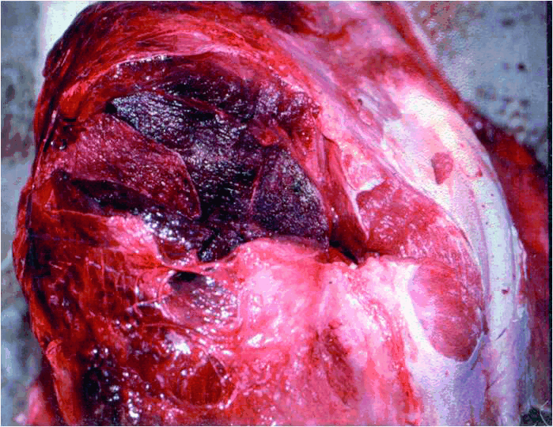
Cl.chauvoei
Blackleg is a necrotizing emphysematous myositis caused by Cl. Chauovei. The organism inhabit primarily the intestine of cattle & sheep, although persistence in soil may be important.
Blackleg occurs most commonly in well-fed cattle less than 3 years of age. Lesions usually occur in hindlimb muscle mass. In sheep the disease more frequently presents as a wound infection resembling malignant edema (Cl. Septicum infection), or gas gangrene (Cl. Perfringens infection).

Slide 7
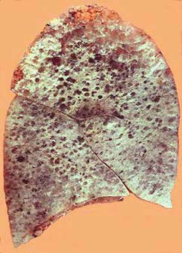
Cl.chauvoei
The periphery of lesions is typically edematous & hemorrhagic, with myonecrosis, whereas the central area of the lesion are often dray & emphymatous.
Ingestion is the most probable route of exposure in cattle & various tissues, especially skeletal muscles are affected.
Damage to the muscles provide suitable conditions for germination of dormant spores with subsequent multiplication and toxin production.

